Slide 1

教学辅助课件
牛津 七年级下

Slide 2


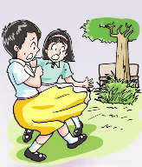

The ghost in the park
Unit 5 Amazing things
study skills

Slide 3

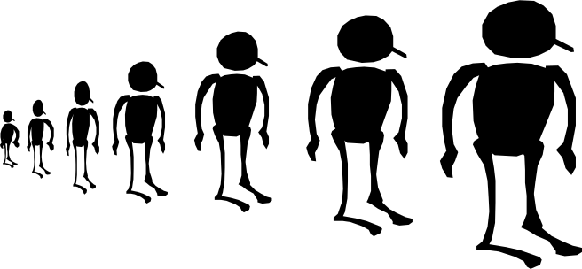
Objectives
To know the different pronunciations of the -ed ending: /t/ /d/ /id/
To pronounce words with -ed correctly

Slide 4
Review
Read the following sentences and pay attention to the verbs ending in the letters –ed.
/d/
1. They turned around.
2. “What happened?” Andy asked.
3. Andy helped me with my English.
4. He stood beside the tree and shouted, “Help! Help!”
5. Andy picked up the little cat.
/d/
/t/
/t/
/id/
你读对了吗？
它们的发音有
不同吗？
/t/

Slide 5

写出下面各词语的过去分词形式。
dance play hate
help live need
talk answer visit
shop carry shout
ed
ed
ed
ed
ed
ed
ed
ed
ed
ped
ied
ed
How do you pronounce the endings? Listen carefully and repeat these words.
清辅音(如/p/,/k/,/s/）后的-ed读/t/
浊辅音（如/v/）和元音（如/ei/,/ə/,/i/）后的-ed读/d/
/t/和/d/后的-ed读音为/id/

Slide 6
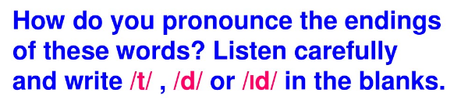

P65
/t/
listened ___ 5. started ___ 9.stopped ___
2. liked ___ 6.chatted ___ 10. raised ___
3. wanted___ 7. finished ___ 11. walked ___
4. hoped ___ 8. passed ___ 12. turned ___
/d/
/id/
/t/
/id/
/d/
/id/
/t/
/t/
/t/
/t/
/d/

Slide 7

Millie and Kitty met Sandy outside a museum. Listen to their conversation. Pay attention to the different pronunciations of the –ed ending.
C
P65

Slide 8
听力原文
/d/
Millie: Sandy, you’re late. The museum closed just a minute ago.
Sandy: Sorry. My grandma visited us this afternoon, so I stayed at home and talked to her.
Kitty: That’s OK.
Sandy: I hope you enjoyed your day. What did you do?
Millie: We watched a short film. It showed a lot of amazing things in the world.
Kitty: Then we played some amazing games. It was fun! We’re going to come here again next weekend.
Sandy: Let me come with you then!
/id/
/d/
/t/
/d/
/d/
/d/
/d/

Slide 9
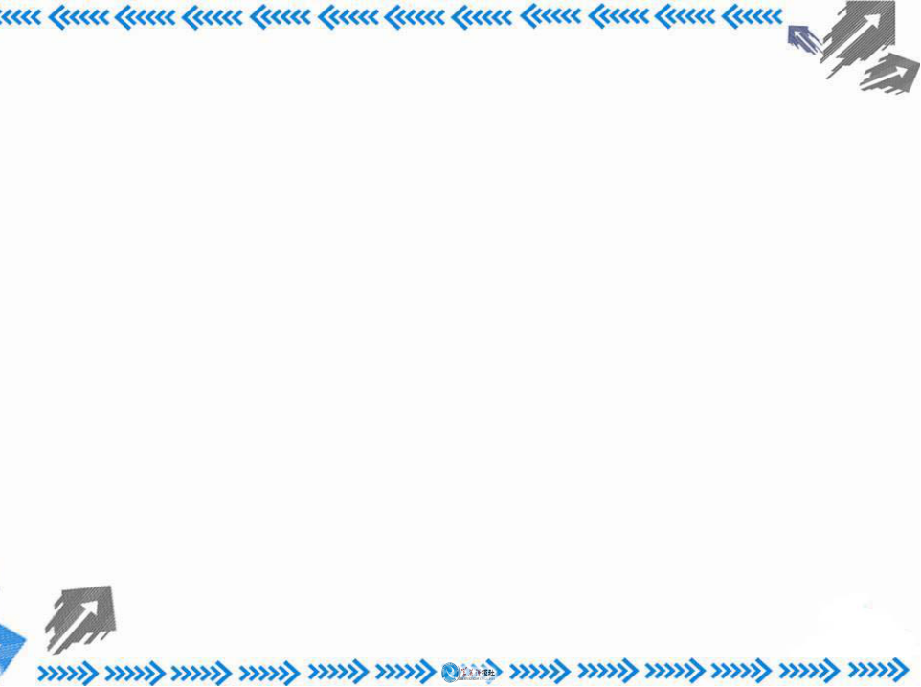


Find more different verbs with –ed endings, and put them into the correct group.
/t/
/d/
/id/

Slide 10
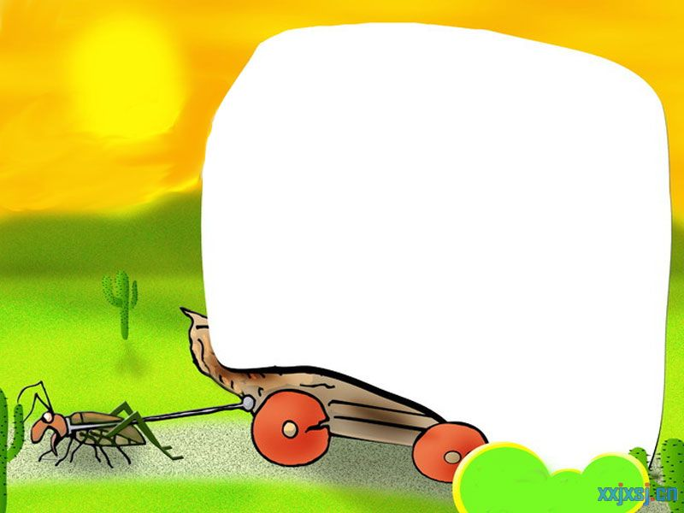



Slide 11

默读下面的单词，将词尾-ed的发音填在后面的横线上。
/t/
1. looked___ included___ stayed ___
2. missed___ followed___ painted___
3. sounded___ washed ___ fitted ___
4. cried___ shared ___ checked ___
/id/
/d/
/t/
/d/
/id/
/id/
/t/
/id/
/d/
/d/
/t/

Slide 12


1. Read the passage and dialogues in this unit with correct pronunciation.
2. Preview Task on P66.

